Slide 1
Bapatla Engineering College::Bapatla
Department of Information Technology
Project Review-I
on
Online Car Rental System
By
Pothamsetty Hari Prasad-Y22AIT497
Shaik Nagoor Basha-Y22AIT508
Vanja Sasi Kumar-Y22AIT521
Madasani Sasi Kiran-Y22AIT468
Under the Esteemed Guidance
Of
P. Ratna Prakash M. Tech,(Ph.D)
Assistant Professor

Slide 2
Title
Online Car Rental System

Slide 3
Table of Contents
Abstract
Introduction
Problem Statement
Literature Survey
Existing System
Proposed System
System Architecture
Requirements
Modules
Conclusion

Slide 4
Abstract
The Online Car Rental System is a full-stack web application designed to streamline the vehicle rental process. It allows users to register with driving license verification, browse and filter cars, and book vehicles with automatic price calculation. The system ensures secure authentication and prevents overlapping bookings through availability checks. An admin panel enables efficient management of users, cars, and bookings. Built using MVC architecture, the application improves efficiency, security, and user experience in car rental services.

Slide 5
Introduction
The Online Car Rental System is a web-based application developed to simplify the process of renting vehicles digitally. It provides an easy platform for users to register, explore available cars, and make bookings efficiently. The system includes secure authentication and driving license verification to ensure reliability. Additionally, an admin module helps manage cars, users, and bookings effectively.

Slide 6
Problem Statement
The traditional car rental process is manual, time-consuming, and lacks transparency for users. Customers face difficulty in checking availability and making quick bookings. Existing systems often lack proper user verification and efficient booking management. Hence, a secure and automated Online Car Rental System is needed to improve efficiency and user experience.

Slide 7
Literature Survey
Existing studies on car rental systems highlight the shift from manual to web-based platforms for improved efficiency and accessibility. Research emphasizes the importance of secure user authentication and data management in such systems. Many works focus on features like online booking, availability checking, and admin control modules. These studies provide a foundation for developing a reliable and user-friendly Online Car Rental System.

Slide 8
Existing System
The existing car rental system is mostly manual or semi-digital, requiring physical visits or phone-based bookings. It lacks real-time vehicle availability and efficient booking management. Customer verification processes are often weak, leading to security issues. Additionally, managing records and preventing booking conflicts is difficult in such systems.

Slide 9
Proposed System
The proposed Online Car Rental System is a web-based solution that automates the entire vehicle rental process. It enables users to register with driving license verification, browse available cars, and book vehicles easily with real-time availability checks. The system ensures secure authentication and prevents overlapping bookings. An admin module efficiently manages users, cars, and bookings, improving overall system performance and user experience.

Slide 10
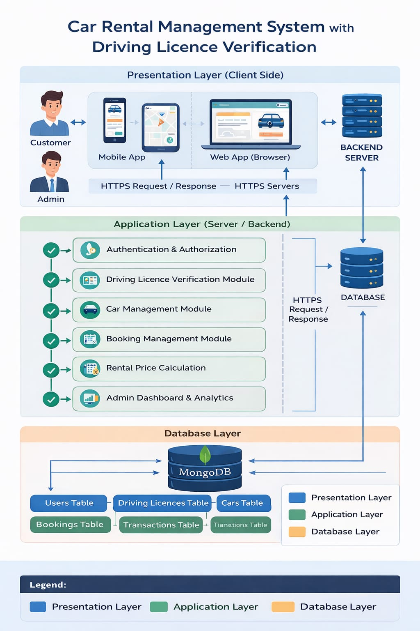
System Architecture

Slide 11
Algorithm Used
Car Availability Checking Algorithm – Prevents overlapping bookings by verifying date conflicts before confirming reservations.
Password Hashing Algorithm (bcrypt) – Ensures secure storage of user passwords.
Search and Filtering Algorithm – Helps users find cars based on price, fuel type, and seating capacity.
Booking Price Calculation Algorithm – Calculates total rental cost based on the number of days.

Slide 12
Requirements
Software Requirements:
• Operating System: Windows / Linux / macOS • Frontend: HTML, CSS, JavaScript, Bootstrap • Backend: Node.js with Express.js • Database: MongoDB • Tools: VS Code, Web Browser (Chrome/Edge), Git

Slide 13
Hardware Requirements:
• Processor: Intel i3 or above • RAM: Minimum 4 GB • Storage: 500 GB HDD or 256 GB SSD • System Type: 64-bit Computer • Internet Connection for development and testing

Slide 14
Modules Used
Driving License Verification Module – Manages upload and admin verification of user licenses.
User Authentication Module – Handles user registration, login, and secure password management.
Booking Management Module – Handles car booking, cancellation, and booking status updates.
Car Management Module – Allows admin to add, update, delete, and manage car details.
Admin Dashboard Module – Provides analytics and controls for managing users, cars, and bookings.
Car Search & Filter Module – Enables users to search and filter cars based on preferences.

Slide 15
Conclusion
The Online Car Rental System provides an efficient and user-friendly solution for managing vehicle rentals digitally. It simplifies the booking process, ensures secure user authentication, and prevents booking conflicts through proper validation. The system also enables administrators to manage cars, users, and bookings effectively. Overall, it improves reliability, reduces manual effort, and enhances the user experience in car rental services.

Slide 16
Any Recommendations?

Slide 17


